Slide 1


GIT
Presented By: Mohd Uzair
Notes:
Note: First “Right Click” on the Gradient background, go to “Order” option and “Send it to Back”, then insert your picture into “Image Placeholder”, “Right Click” on the picture and again go to “Order” option and “Send it to Back” to get the “Gradient” effect.

Slide 2

Our Agenda
What is git?
git commands
git repository
git commit
git checkout

Slide 3

What is git?
Open source project originally developed in 2005 by Linus Torvaids.
A command line utility.
You can imagine git as something that sits on top of your file system and manipulates files.
A distributed version control system- DCVS

Slide 4
git commands
git init
git clone
git log
git diff
git status
git add
git commit
git checkpoint

Slide 5
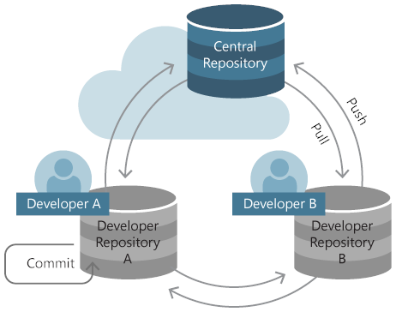
git repository
The purpose of git is to manage a project, or a set of files, as they change over time. Git stores this information in a structure called a repository.
A git repository contains set of commits.

Slide 6
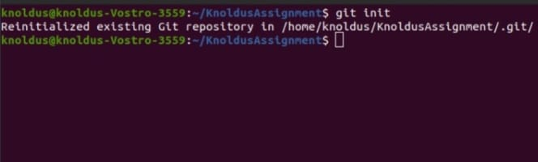
Creating an empty repository using git init command

Slide 7
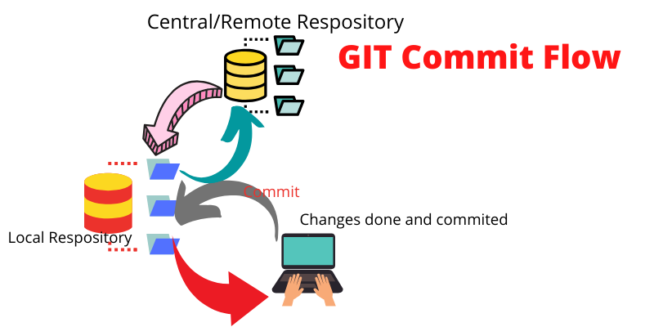
git commit-engrave it in stone
Commits can be thought of as snapshots or milestones along the timeline of a Git project. Commits only what you staged
Commits are created with the git commit command to capture the state of a project at that point in time.

Slide 8
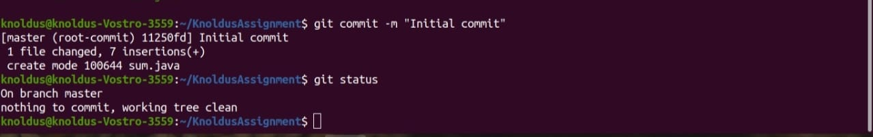
Git commit example

Slide 9
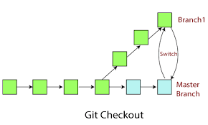
git checkout
The git checkout command lets you navigate between the branches created by git branch .
Checking out a branch updates the files in the working directory to match the version stored in that branch, and it tells Git to record all new commits on that branch.

Slide 10
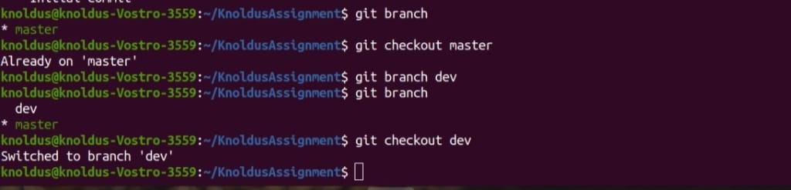
Git checkout example

Slide 11
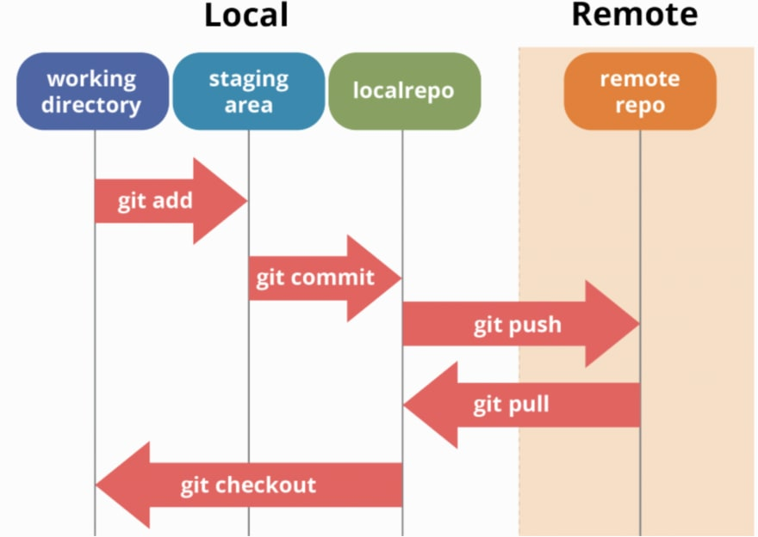
git workflow

Slide 12
Thank You !

